Slide 1
Weekly Meeting
Jan 26, 2022
Gwangwoo Kim

Slide 2
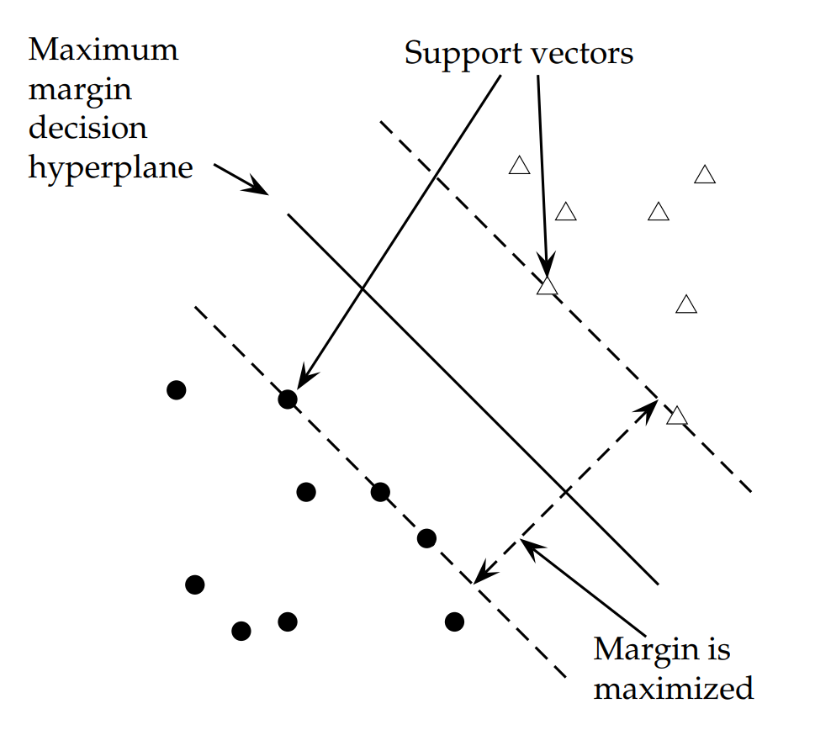
3 Linear Support Vector Machines

Slide 3


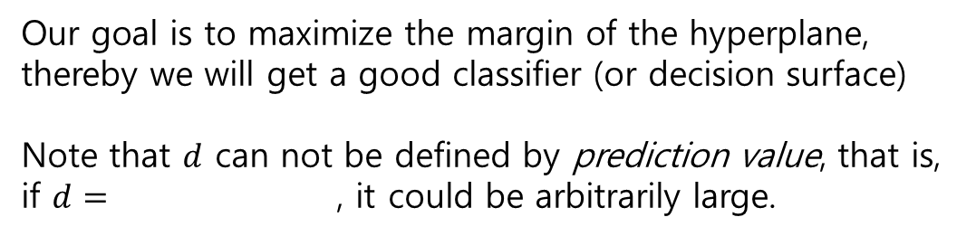




3.1 The Separable case
(margin) = $d_{+}+d_{−}$
Our goal is to maximize the margin of the hyperplane,
thereby we will get a good classifier (or decision surface)
Note that $d$ can not be defined by prediction value, that is,
if $d=$ , it could be arbitrarily large.
$$d_{+}$$
$$d=$$
$=$
$$d_{−}$$
because both are the same expressions of the hyperplane

Slide 4
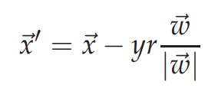
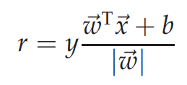
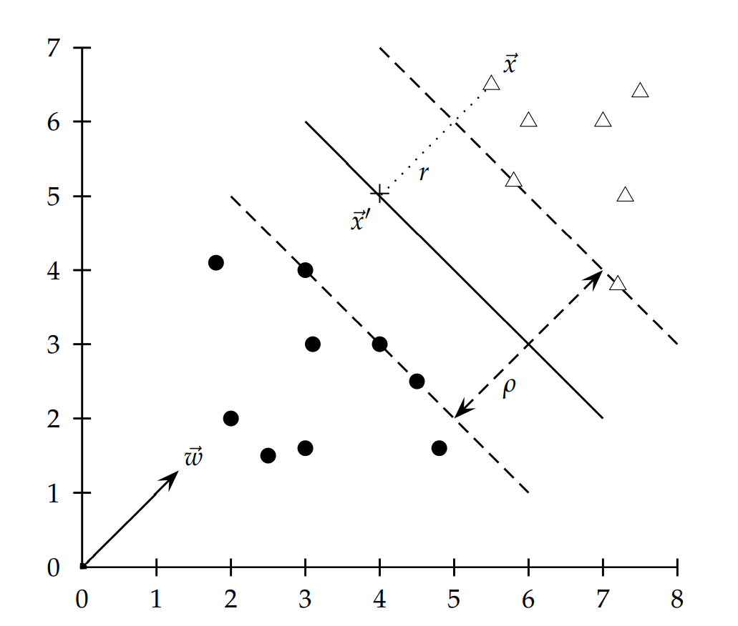


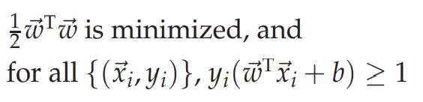
3.1 The Separable case
This is invariant from scaling. Therefore, we may assume that
When the equality holds, the distance becomes
$$d_{+}$$
$$d_{−}$$
Our final problem is given by

Slide 5
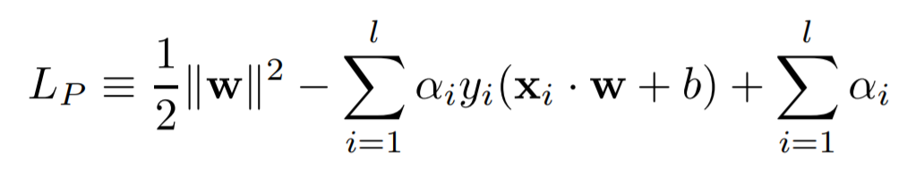
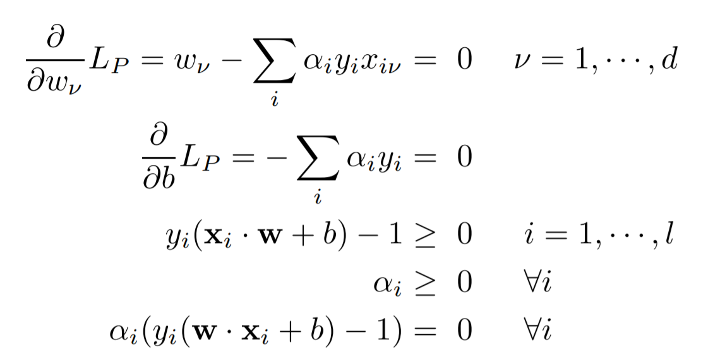
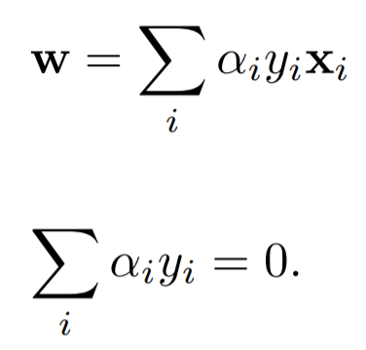
3.2 The KKT conditions
Lagrangian
Conclusion
KKT
positive alpha -> support vector

Slide 6
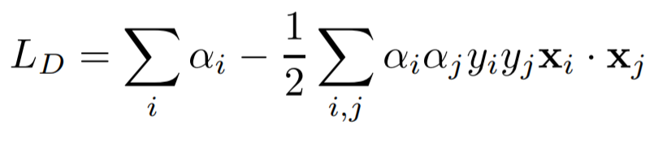

3.2 The KKT conditions
plugging
This is (roughly) concave, so we should maximize it
subject to
Quadratic Programming
<Note>
The solution vector alpha may not be unique.
If have alpha, then we can get (w,b) by calculating
Most of alpha are 0

Slide 7

3.4 Test phase
Just see

Slide 8
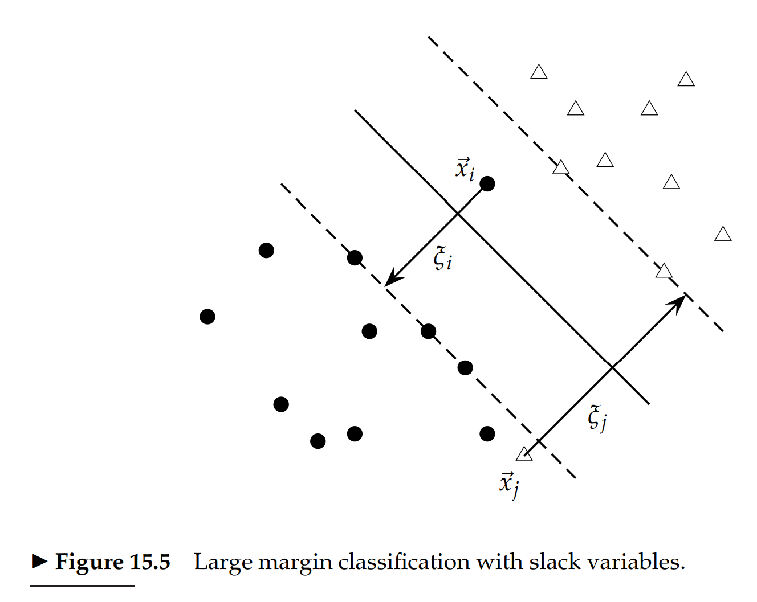
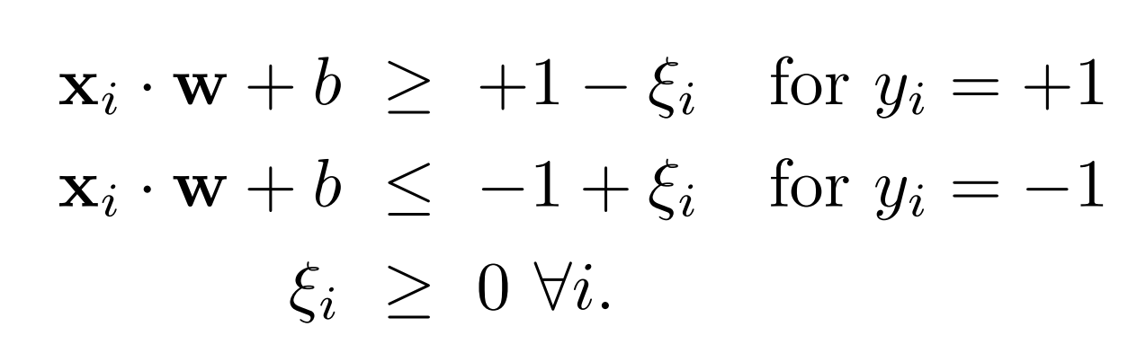
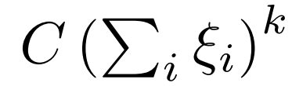
3.5 The Non-Separable case (Soft margin classification)
Slack variables
New constraint
Additional loss term (usually k=1)

Slide 9


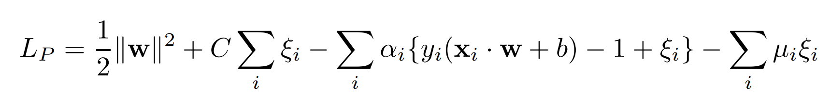
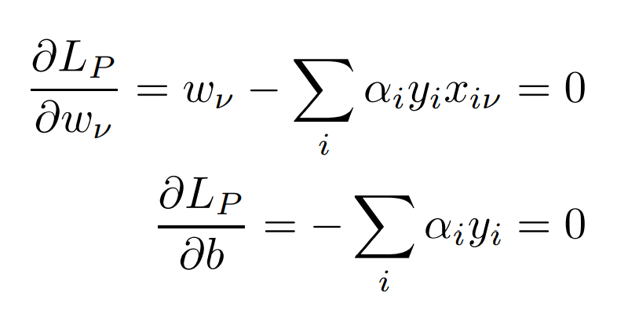
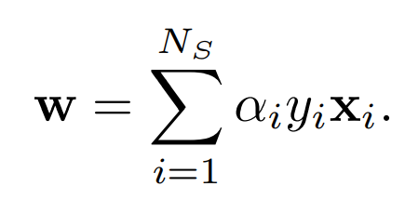
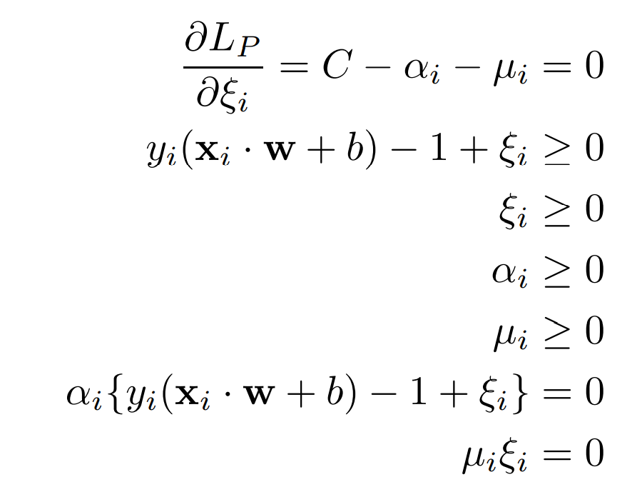
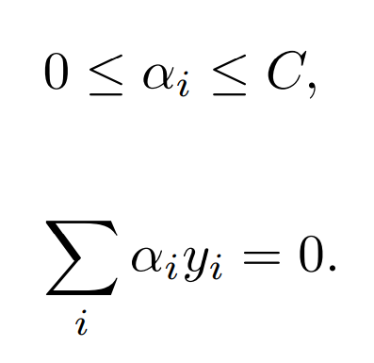


3.5 The Non-Separable case (Soft margin classification)
Minimize
Subject to
Lagrangian
KKT
Conclusion
<Note>

Slide 10
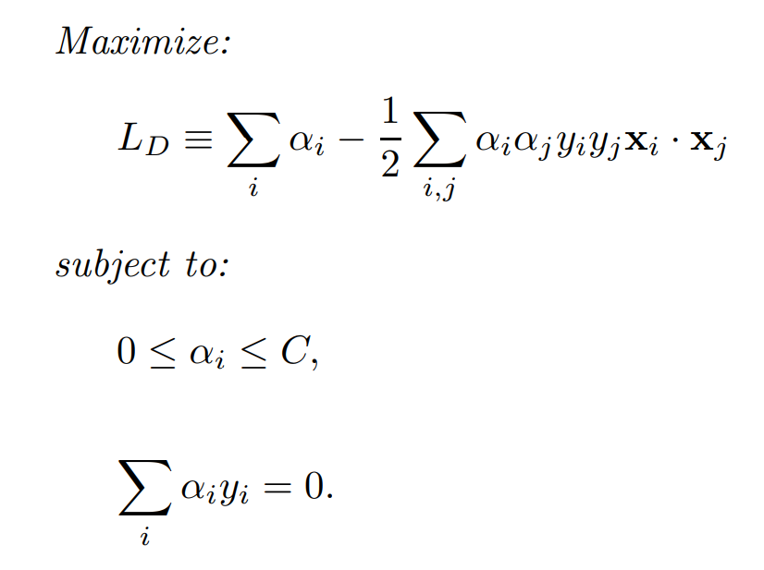
3.5 The Non-Separable case (Soft margin classification)
Quadratic Programming

Slide 11
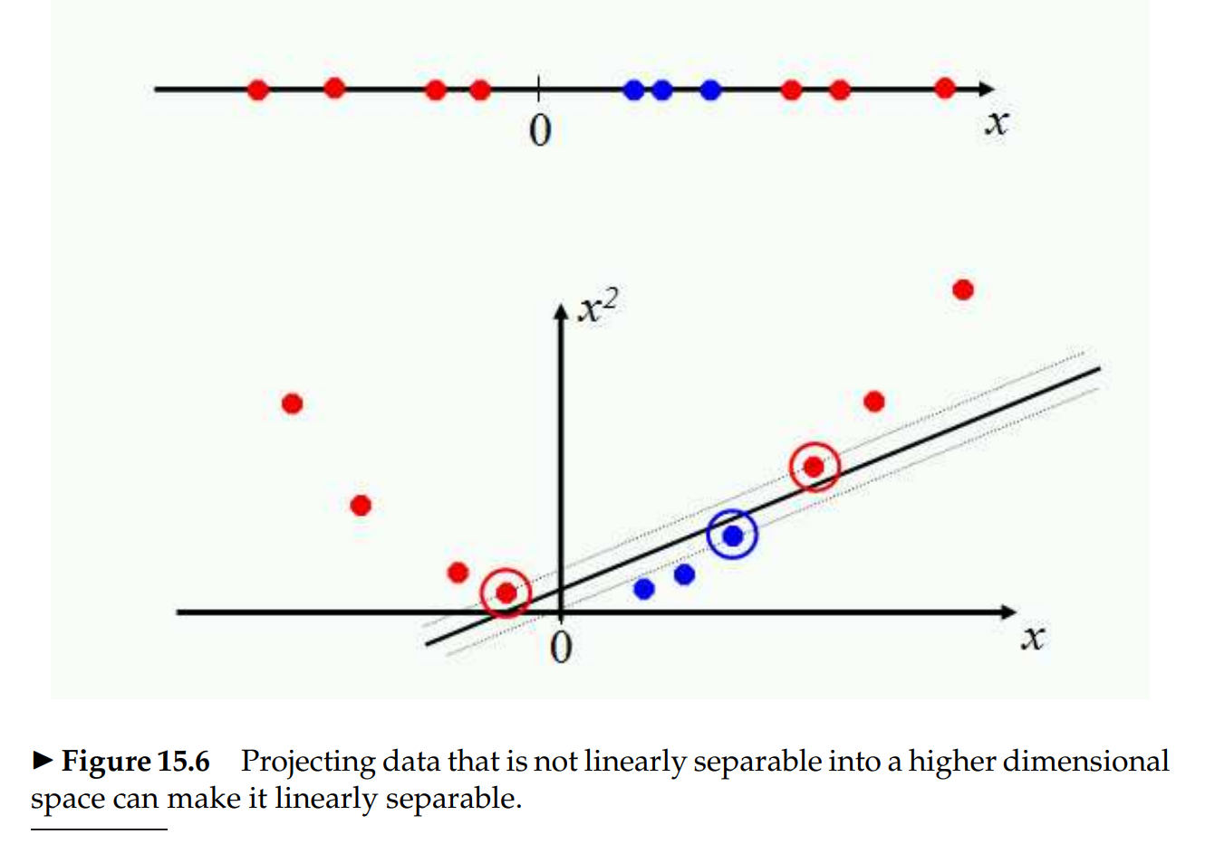
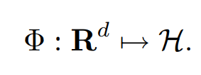
4 Nonlinear SVMs

Slide 12


4 Nonlinear SVMs
Observation: In high dimension space,
?
=
Mercer kernel

Slide 13
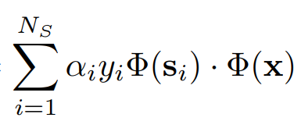
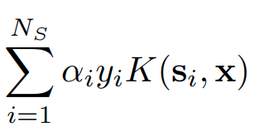

4 Nonlinear SVMs
Note: After QP, we do not have to calculate
In fact, we only need to calculate
but
for b
for test
=
=
So, if there is a proper kernel, we can obtain a nonlinear SVM

Slide 14


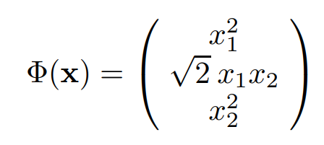
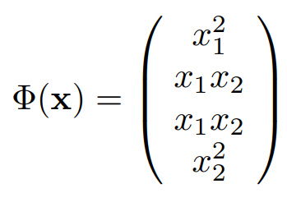
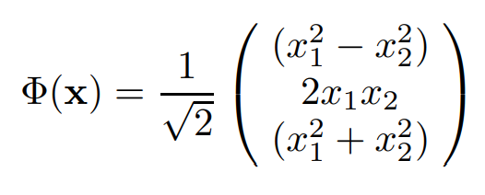
4 Examples
Definition: A kernel function K is such a function that corresponds to a dot product in some expanded feature space.
Example 1:
Example 2: Phi is not unique:

Slide 15

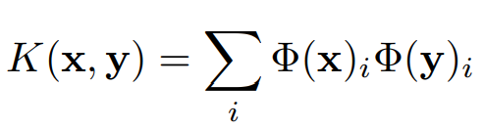
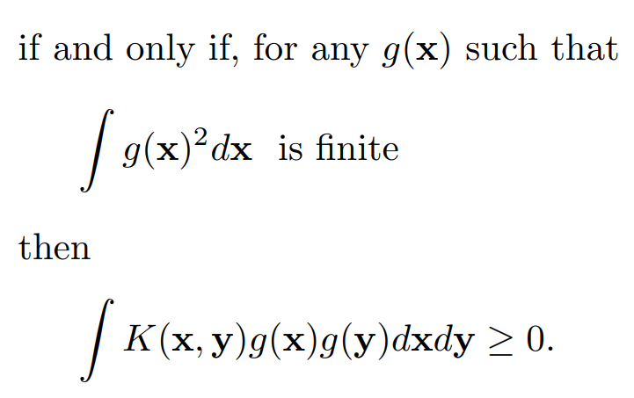
4.1 Mercer’s Theorem
Theorem (Mercer): Given a pair , the kernel with the property exists

Slide 16
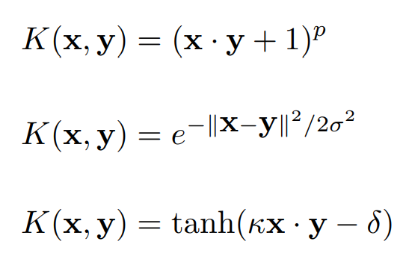
4.3 Examples
Mercer kernels
Polynomial kernel, which allows us to model feature conjunctions
(dim(H)= d+p-1 choose p)
Radial Basis Function allows you to have features that pick out circles (dim(H)=infinity)
A particular kind of two-layer sigmoidal neural network.

Slide 17
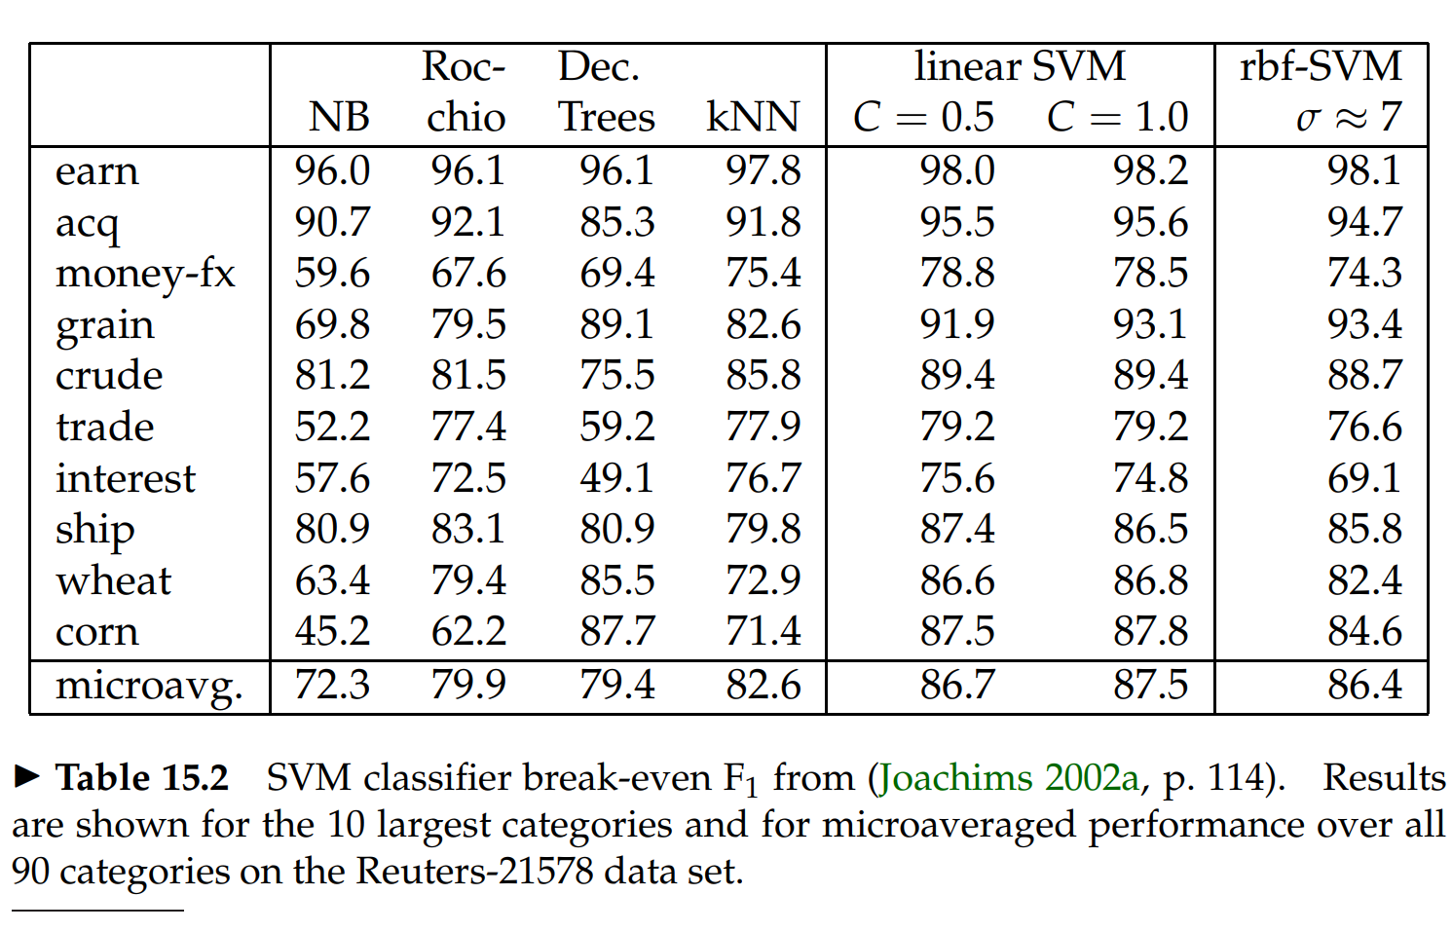
4.4 Experimental results

Slide 18
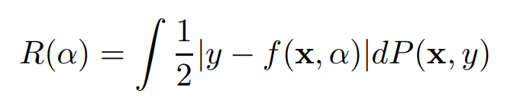
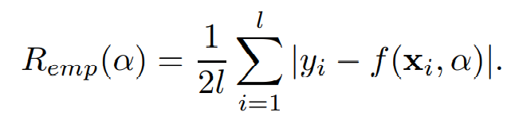
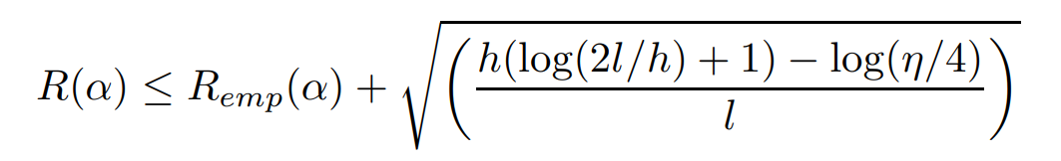

2. A Bound on the Generalization Performance
Expected risk or actual error
Empirical risk

Slide 19
2. A Bound on the Generalization Performance
Risk bound
VC confidence
Note
It is independent of PDF
It is not possible to compute the LHS
If we know h, then we are choosing that machine which gives the lowest upper bound on RHS

Slide 20
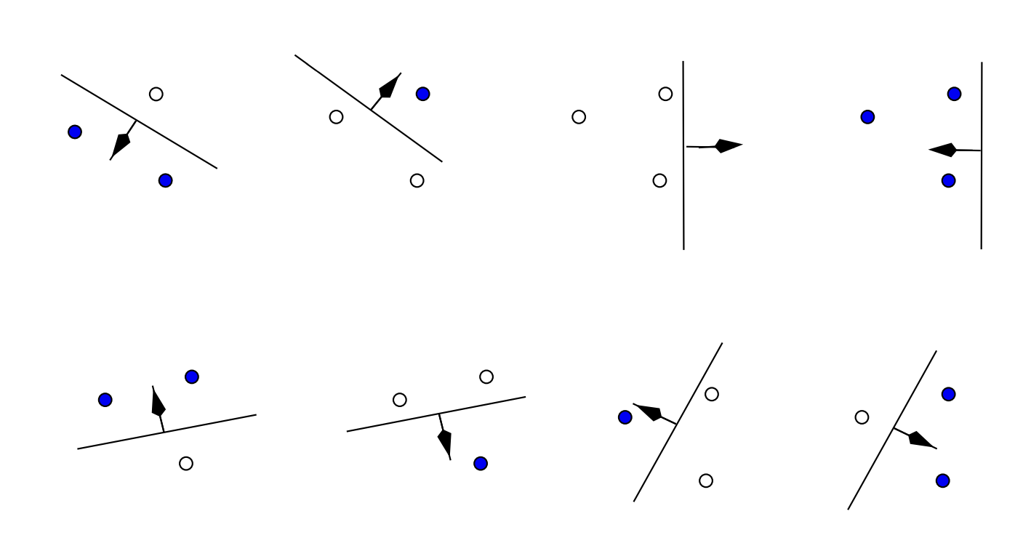
2.1 The VC Dimension
Definition: If a given set of L points can be labeled in all possible 2^L ways,
and for each labeling, a member of the set {f(α)} can be found which correctly assigns those labels,
we say that that set of points is shattered by that set of functions.
The VC dimension for the set of functions {f(α)} is defined as the maximum number of training points
that can be shattered by {f(α)}.
Example: the VC dimension of the set of oriented lines in the plane is 3.

Slide 21
2.1 Note for the infinite case
Note: Consider the k’th nearest neighbour classifier, with k = 1.
This set of functions has infinite VC dimension and zero empirical risk,
since any number of points, labeled arbitrarily, will be successfully learned by the algorithm.
Thus the bound provides no information.
However, even though the bound is not valid, nearest neighbour classifiers can still perform well.
Thus this example is a cautionary tale: infinite “capacity” does not guarantee poor performance.

Slide 22
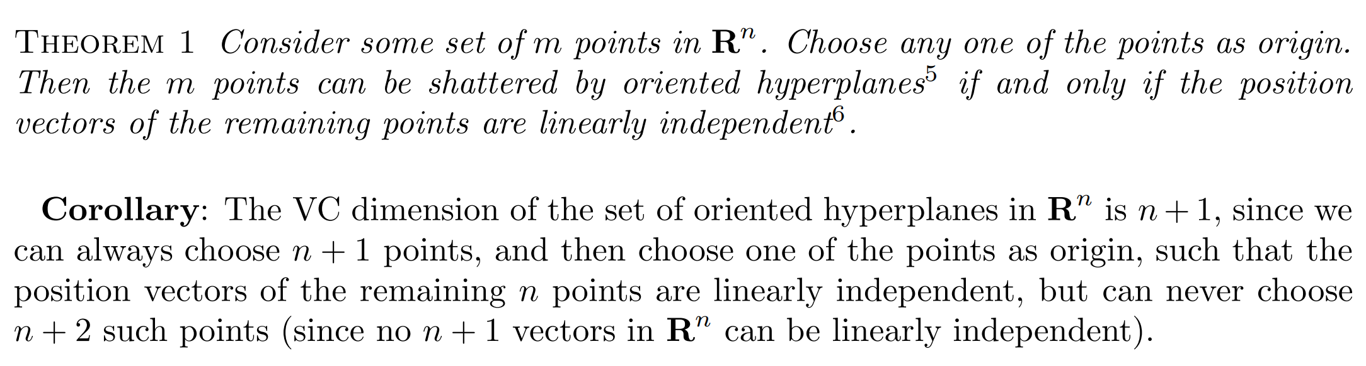
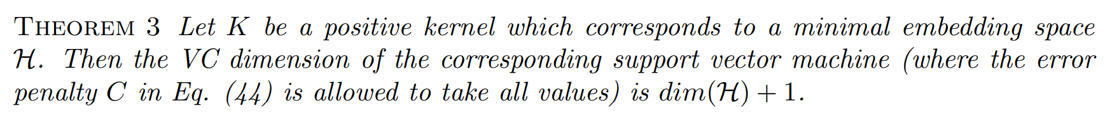
6. The VC Dimension of Support Vector Machines

Slide 23
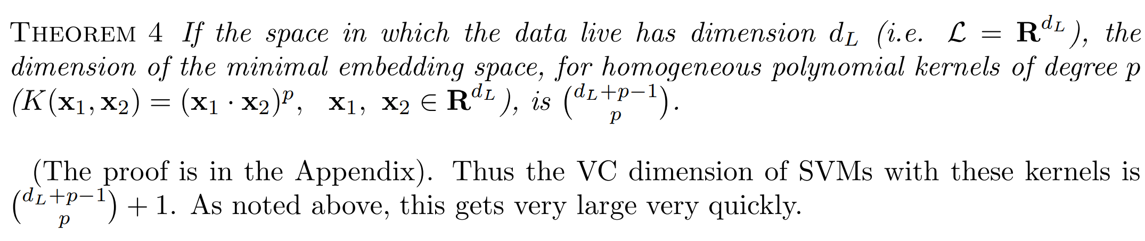
6.1 The VC Dimension for Polynomial Kernels

Slide 24
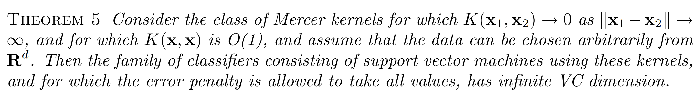
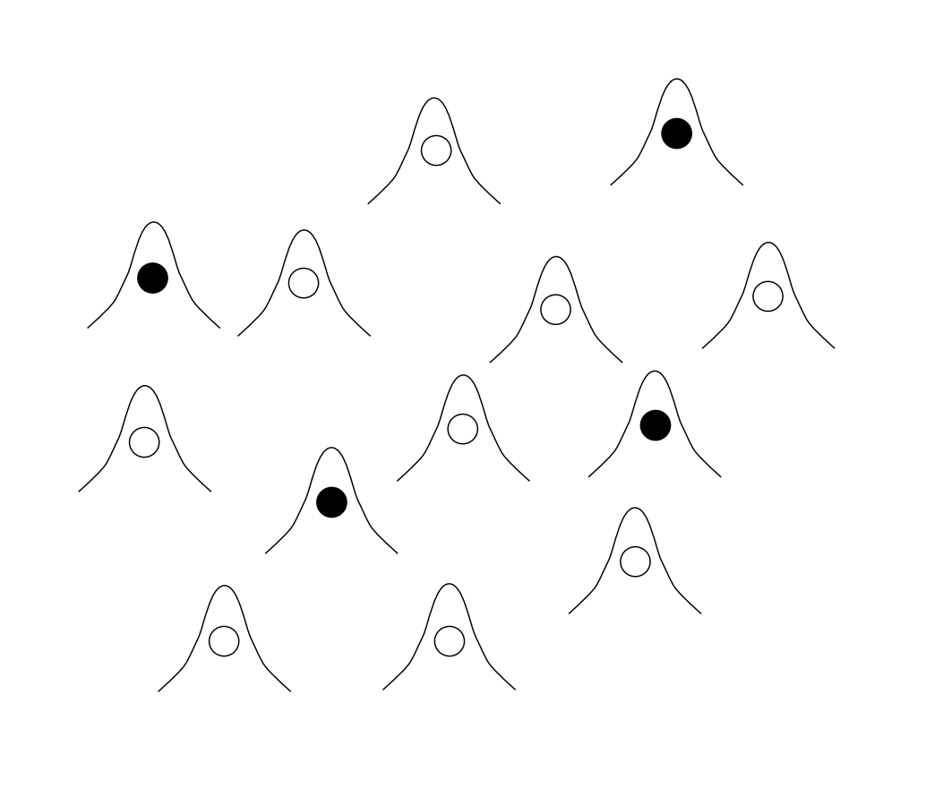

6.2 The VC Dimension for Radial Basis Function Kernels
e.g.

Slide 25
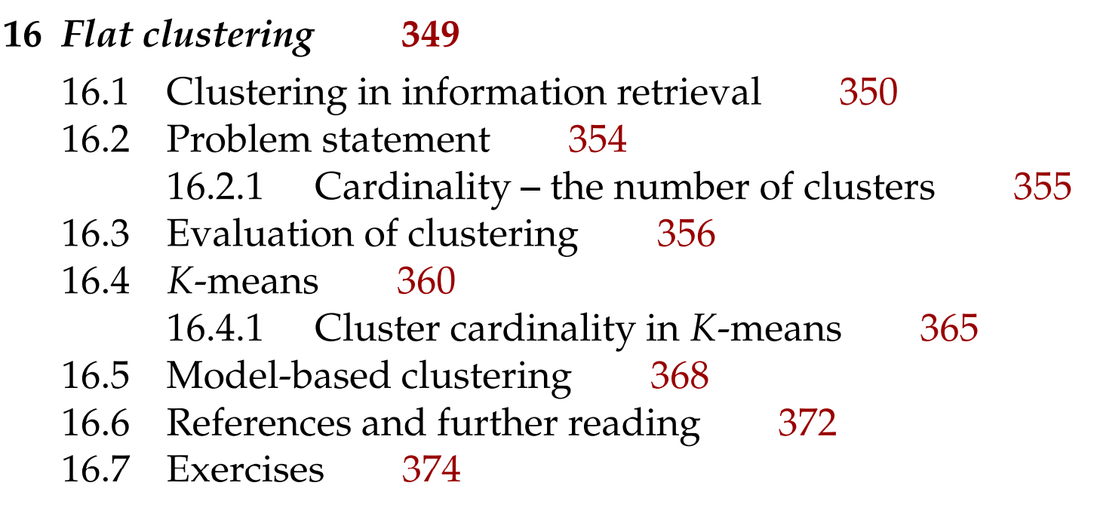
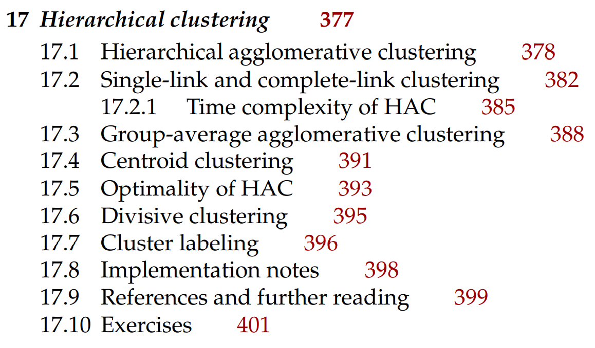
Next

